Slide 1

Session 7
Linear Programming – Transportation
Big Data and Analytics
Topic 8: Predictive Modelling
We will wait for 5 mins for everyone to join

Slide 2

Recap
Linear Programming – Transportation
What we discussed last week?

Slide 3
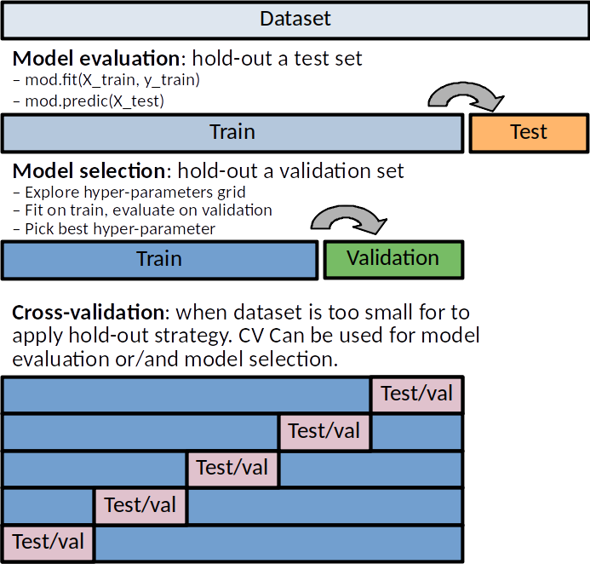
Recap: Evaluation
Train, Validate, Test
Training Set: Model learns patterns
Test Set: Model is evaluated on unseen data
Optionally: Validation set for tuning
Think of it as a practice test before your final exam
You might ask – why do we need a validation set?
To prevent overfitting – if your model does great on training data but poorly on validation data, may be its just memorizing as it is
To fine-tune the model
To decide when to stop training
Notes:
Picture Source:https://duchesnay.github.io/pystatsml/auto_gallery/ml_resampling.html

Slide 4
Recap: Evaluation
Evaluation Metrics
Could you point out are the following metrics for classification, regression, clustering or reinforcement learning?
Accuracy, Precision, Recall, F1-Score
Mean Squared Error (MSE)
Silhouette Coefficient
Average Reward
ROC Curve and AUC (Area Under the Curve)
Success Rate
Davies-Bouldin Index
R-Squared and Adjusted R-Squared
Classification: Categorising data into predefined classes
Regression: Predicting continuous values
Clustering: Grouping similar data points
Reinforcement Learning: Learning by interacting with an environment

Slide 5
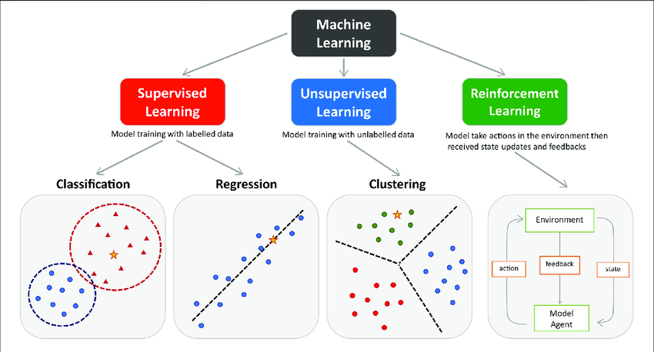
Predictive Modelling
Predictive modelling or predictive analytics: Estimates future outcomes based on historical data using statistical algorithms and machine learning (ML) techniques.
Predictive models attempt to represent the influence that a set of (independent) variables have on the outcome of another (dependent) variable of interest.
Based on this definition, on which category of ML predictive models can be applied?
Notes:
Regression: Predicting continuous values, such as the price of a house or stock, or temperature forecasts.
Classification: Predicting discrete outcomes, such as whether an email is spam or not, or if a credit card transaction is fraudulent.
While predictive modelling is most closely aligned with supervised learning, there are aspects of it that can be related to other types of machine learning:
In unsupervised learning, predictive modelling could be used for anomaly detection where the model predicts which instances in new data don't fit the pattern of the training data.
In reinforcement learning, predictive models can be used to estimate the future rewards for different actions, even though the primary goal is not prediction but rather to learn a policy of actions.

Slide 6
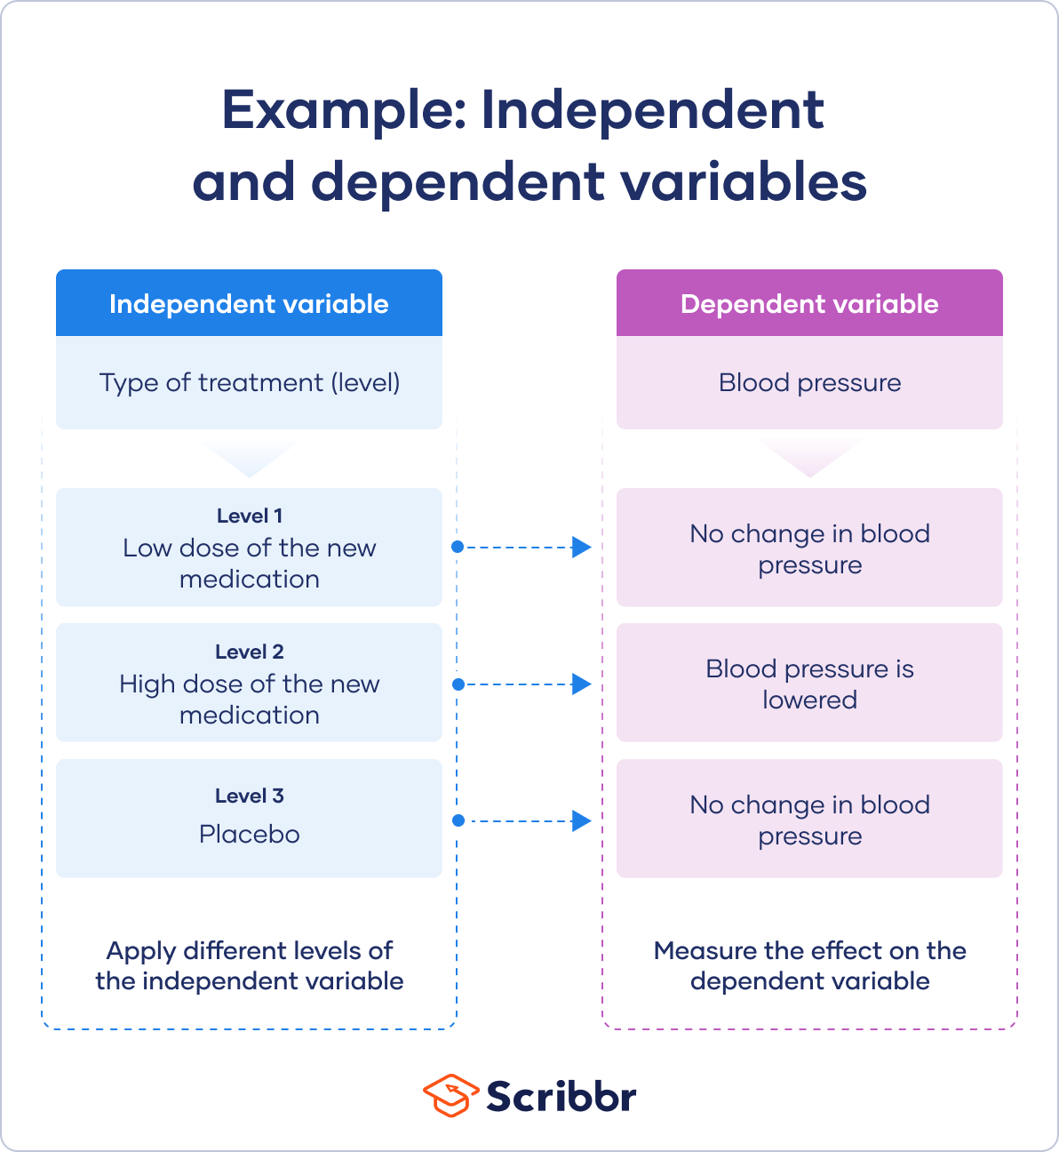
Predictive Modelling
Predictive models attempt to represent the influence that a set of (independent) variables have on the outcome of another (dependent) variable of interest.
Independent Variable: This is the variable that is manipulated or changed to see how it affects the dependent variable. It is sometimes referred to as the "predictor" or "explanatory" variable.
Dependent Variable: This is the variable that is being tested and measured. It is "dependent" because its value depends on the values of the independent variable. It is also known as the "response" or "outcome" variable.
Notes:
Example: Independent variable levels
You are studying the impact of a new medication on the blood pressure of patients with hypertension. Your independent variable is the treatment that you directly vary between groups.
You have three independent variable levels, and each group gets a different level of treatment.
You randomly assign your patients to one of the three groups:
A low-dose experimental group
A high-dose experimental group
A placebo group (to research a possible placebo effect)

Slide 7
Predictive Modelling
Applications:
Marketing and Sales:
Sales Forecasting: Predicting future sales based on historical data.
Customer Segmentation: Grouping customers based on their buying habits and preferences.
Churn Prediction: Identifying customers who are likely to leave or stop purchasing.
Finance:
Credit Scoring: Assessing the creditworthiness of individuals or organizations.
Fraud Detection: Identifying fraudulent activities by analysing patterns in transactions.
Risk Management: Assessing and mitigating financial risks.
Healthcare:
Disease Prediction: Predicting the likelihood of disease based on patient symptoms and history.
Patient Outcomes: Forecasting patient recovery or complications after treatment.
Resource Allocation: Predicting the demand for healthcare resources such as beds, equipment, and staff.
Notes:
Encourage students to have discussion over possible independent and dependent variables in each applications

Slide 8
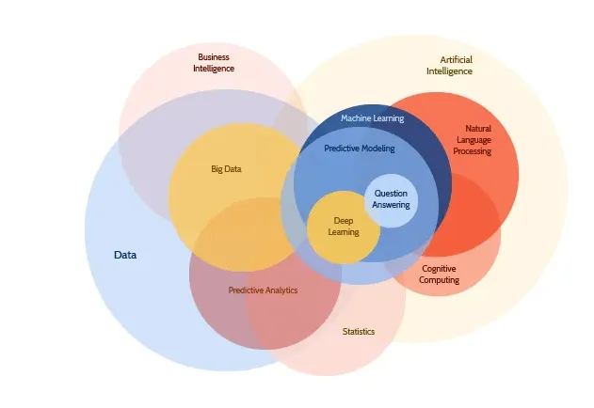
Predictive Modelling
Benefits of Predictive Modelling
Improved decision-making
Enhanced customer experience
Increased operational efficiency
Risk management
Challenges and Limitations
Data quality and availability
Model interpretability
Overfitting and underfitting
Ethical concerns and bias
Notes:
Model interpretability:
Complex predictive models can be difficult to interpret, making it challenging for decision-makers to understand the reasons behind the model's predictions

Slide 9
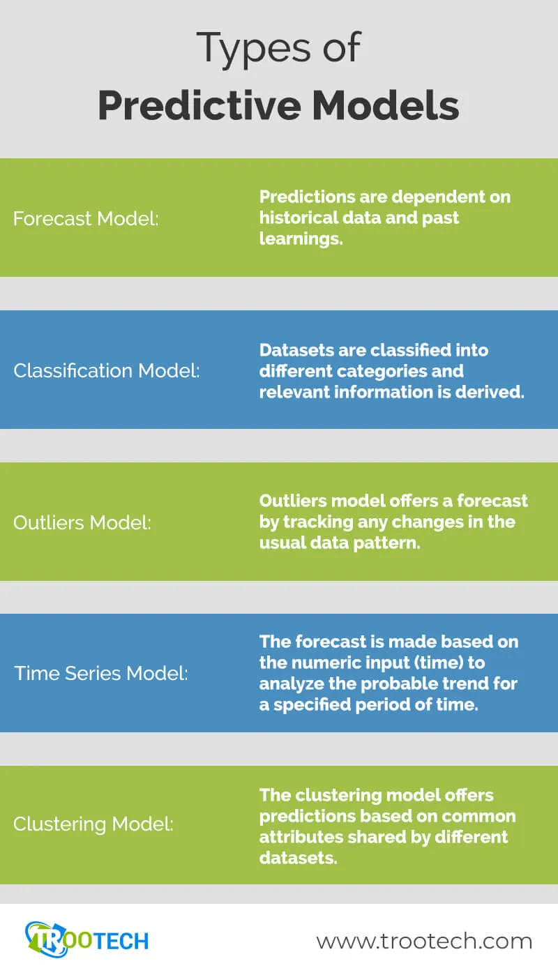
Predictive Modelling
Types of Predictive Models:
Based on applications:
Classification: Predicts categorical class labels.
Regression: Predicts continuous outcomes.
Time-series analysis: Predicts future data points based on historical data.
Clustering: Groups similar data points together.
Based on algorithms:
Generalised Linear Models (GLM)
Logistic Regression
Random Forests
Boosted Regression Trees (BRTs)
Decision Trees
Neural Networks
k-Means Clustering
AutoRegressive Integrated Moving Average
Notes:
Encourage students to point out what types of predictive models for application discussed in previous slide.

Slide 10
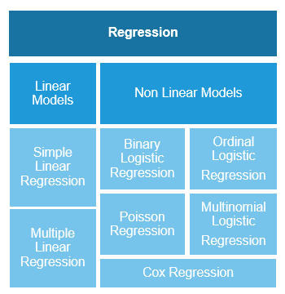
Predictive Modelling
Notes:
You will see different types of regression models, what is regression?
Regression models are used to predict a continuous numerical value based on one or more input variables. The goal of a regression model is to identify the relationship between the input variables and the output variable, and use that relationship to make predictions about the output variable. Regression models are commonly used in various fields, including financial analysis, economics, and engineering, to predict outcomes such as sales, stock prices, and temperatures.

Slide 11
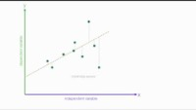
Predictive Modelling
Linear regression
Notes:
https://www.youtube.com/watch?v=zPG4NjIkCjc&t=2s

Slide 12
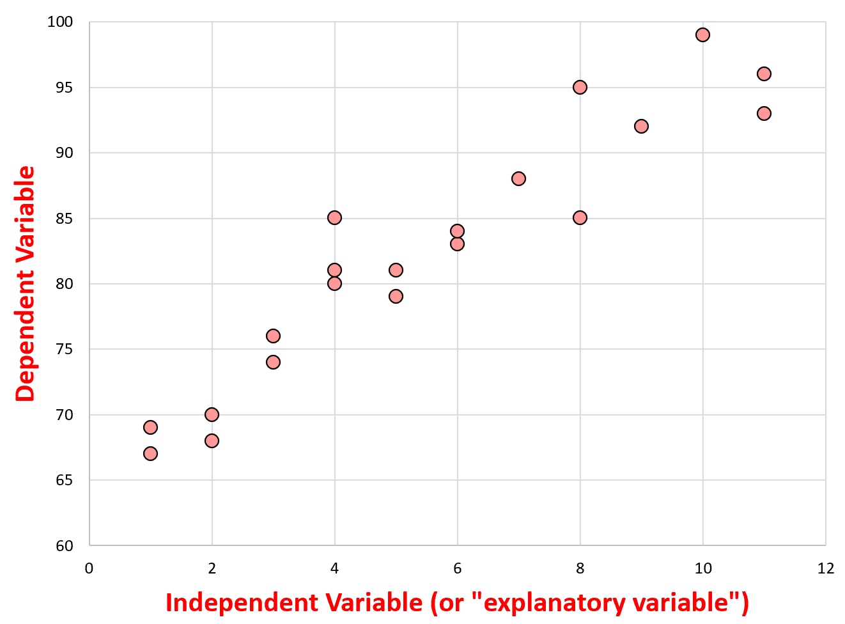
The independent variable belongs on the x-axis (horizontal line) of the graph and the dependent variable belongs on the y-axis (vertical line).

Slide 13
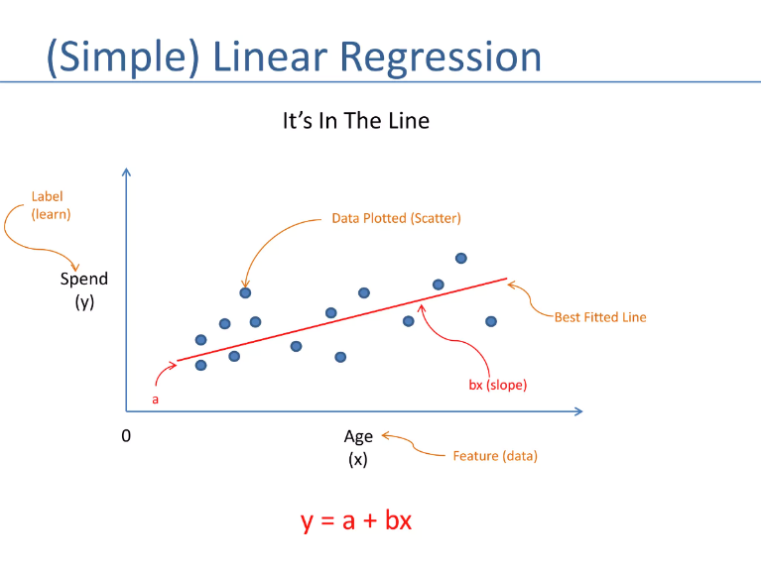
Predictive Modelling
Notes:
simple linear regression models that describe the linear relationship between one independent variable and one dependent variable

Slide 14
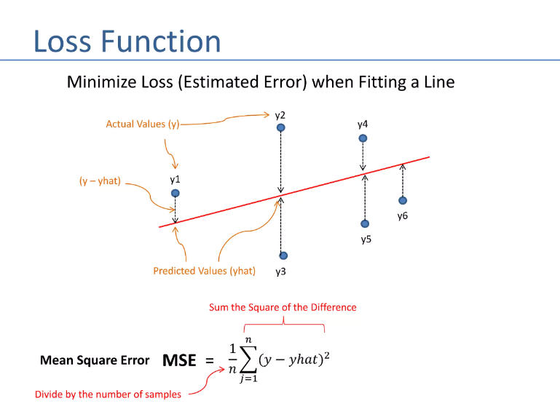
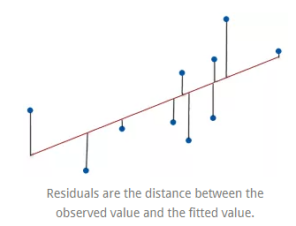
Predictive Modelling

Slide 15
Predictive Modelling
How to find how well a regression model is fitted?

Slide 16
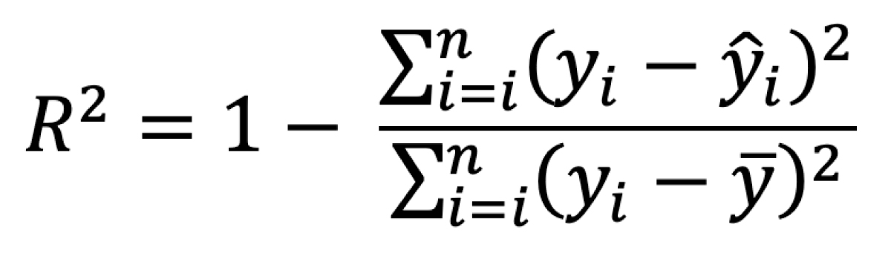
Predictive Modelling
Formal Definition: R-square is a goodness-of-fit measure for linear regression models. This statistic indicates the percentage of the variance in the dependent variable that the independent variables explain collectively.
R-squared is a statistical measure that tells you how close the data are to the fitted regression line. Imagine you have a scatterplot with a bunch of points representing data and you draw a line that best fits all these points. R-squared measures how well this line captures the pattern of the data.
Notes:
Think of R-squared as an accuracy score for a weather forecast. If the weather forecast always predicts the temperature correctly, it's 100% accurate. In the context of R-squared, this would mean an R-squared value of 1 or 100%, indicating that the forecast (or your model's predictions) perfectly matches the actual temperatures (or actual data points).
If the weather forecast is only sometimes accurate, it's like having an R-squared value less than 1. The closer the R-squared value is to 1, the more accurately the model represents the data. If the R-squared value is closer to 0, it means that the model does not do a good job of predicting the actual data points.
So, R-squared gives you an idea of how many data points fall close to the fitted regression line. If R-squared is 0.8, it means 80% of the points fit the model well, whereas the other 20% do not. If it’s low, like 0.3, then the line doesn't fit the points very well, and there's a lot of variation that the model isn't capturing.

Slide 17
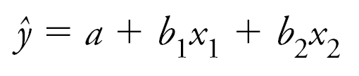
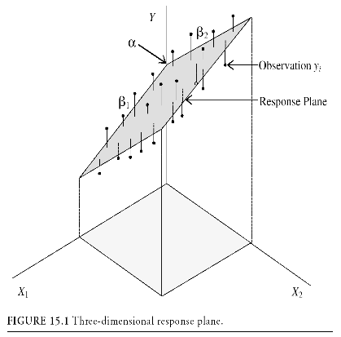
Predictive Modelling
multiple linear regression: that models the linear relationship between one independent variable and multiple dependent variables.

Slide 18
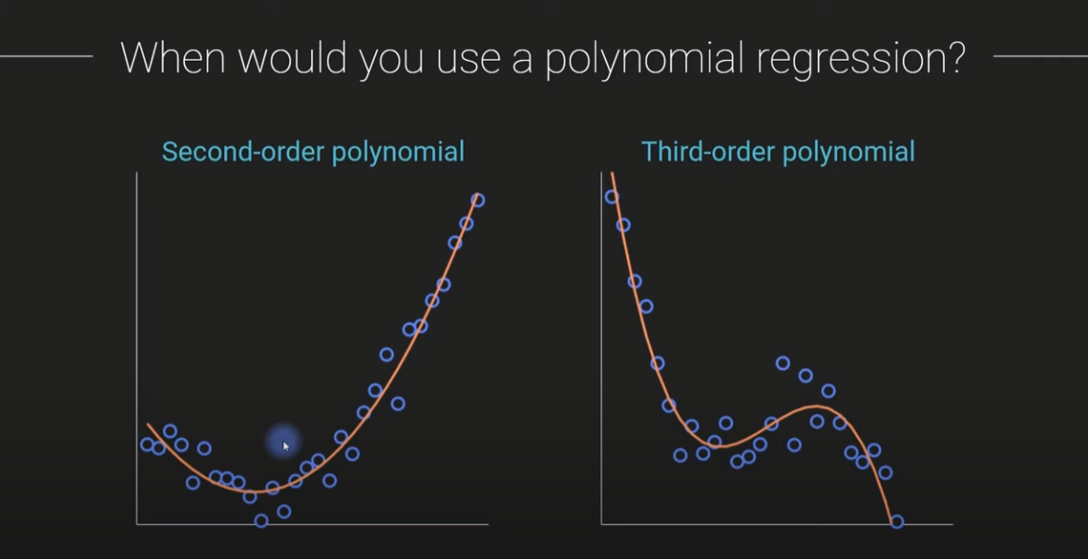
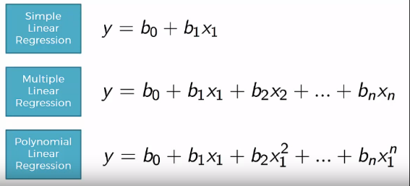
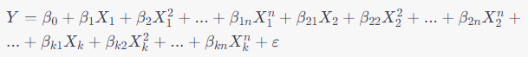
Predictive Modelling
multiple polynomial regression models
It helps capture Non-linear relation between dependent and independent variables.
Notes:
multiple polynomial regression models that capture the relationship between one independent variable and two or more independent variables using n-th degree polynomials

Slide 19
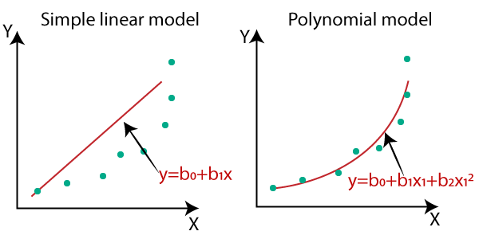
Predictive Modelling

Slide 20
Predictive Modelling
Logistic Regression
Logistic regression is a statistical method for analysing datasets in which there are one or more independent variables that determine an outcome.
The outcome is binary (1/0, Yes/No, True/False).
Used for classification problems, such as spam detection, credit scoring, and medical diagnosis.
Logistic vs. Linear Regression
Linear regression is used for predicting continuous outcomes.
Logistic regression is used for predicting binary outcomes.

Slide 21
Questions?

